Slide 1

BTH645 - Multimedia Elements for User Interfaces
Shi, Yue (Sunny)
sunny.shi@senecacollege.ca
SENECA COLLEGE

Slide 2
Outline
Welcome
Introduction
Course overview
Next week
Introduction to Multimedia
Paper review
2

Slide 3
Get acquainted with each other

Slide 4
Course Overview
Subject Outline:
https://ict.senecacollege.ca/course/bth645
Text Book:
Multimedia: Making It Work, Ninth Edition (May 2014),
by Tay Vaughan,
Publisher: McGraw Hill Osborne Media,
ISBN: 978-0071832885
Seneca Academic Policy:
http://www.senecacollege.ca/academic-policy

Slide 5
Evaluation
Survey Paper 10%
Assignments (3) (10% + 20%+ 15% =) 45%
Test (1) (1 * 25% =) 25%
Labs + in-class activities = 20%
NO Final exam
--------------------------------------------------------------
Total 100%

Slide 6
Course Standards
Assignments & Labs
Late submission: 10% off /each day up to 5 school days
No Work will be accepted afterwards.

Slide 7
Communication
In, before, or after class
Blackboard
Email:
sunny.shi@senecacollege.ca
Important: include your course, section, matrix, subject, details
Individual MS Teams meeting: by appointment

Slide 8
In-class Discussion (1% mark)
5Ws + 1H
What is multimedia?
Why need multimedia? (advantages)
Who/When/where needs multimedia? (examples)
How to create/ deliver multimedia?

Slide 9
Introduction to Multimedia - what
Multimedia is a combination of text, art, sound, animation, and video.
It is delivered to the user by electronic or digitally manipulated means.
A multimedia project development requires creative, technical, organizational, and business skills.
A project can also be launched on the Web.

Slide 10
Introduction to Multimedia - what
Multimedia projects can be linear or nonlinear.
Projects that are not interactive are called linear.
Projects where users are given navigational control are called nonlinear and user-interactive.

Slide 11
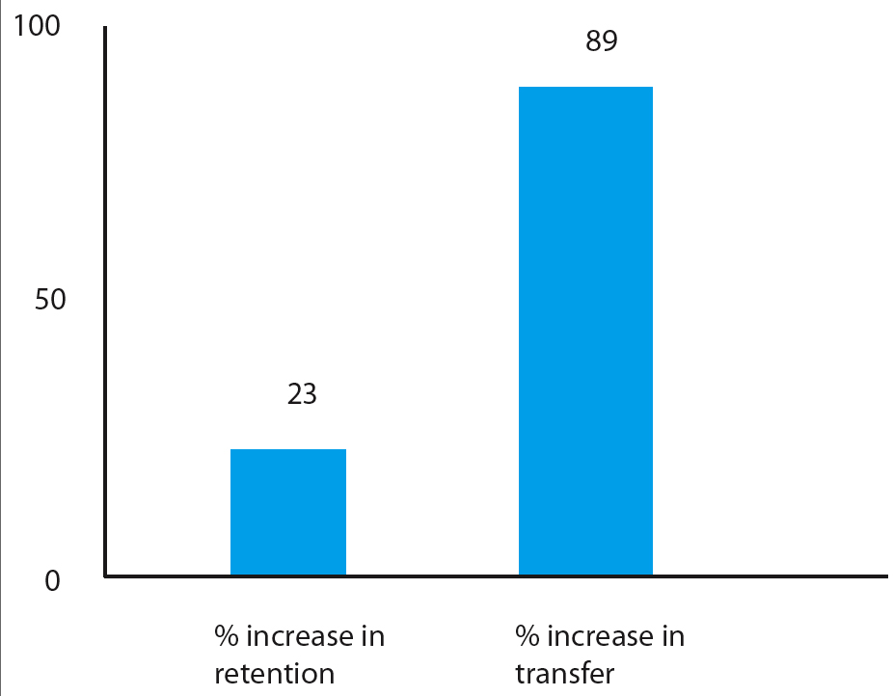
Applications of Multimedia - Why
For viewers presented with graphics && words.
23% increase in retention (ability to remember information)
89% increase in transfer (ability to creatively apply information)

Slide 12
Applications of Multimedia – who/when/where
Business - Business applications for multimedia include:
presentations training,
marketing,
advertising,
product demos,
databases,
catalogs,
instant messaging,
networked communication.

Slide 13
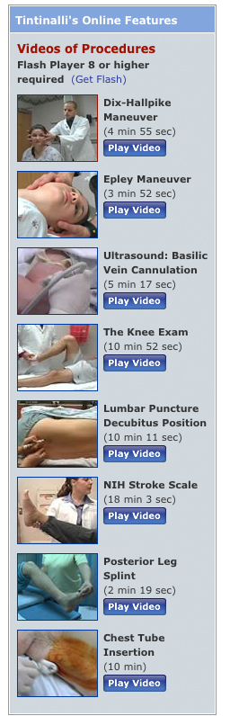
Applications of Multimedia
–who/when/where/why
Schools - Educational software can be developed to enrich the learning process.
Figure on the right:
instructional videos used for training emergency medicine specialists.
Advantages include:
Such online e-learning provides a cost-effective vehicle to learn clinical techniques outside of the hospital setting.

Slide 14
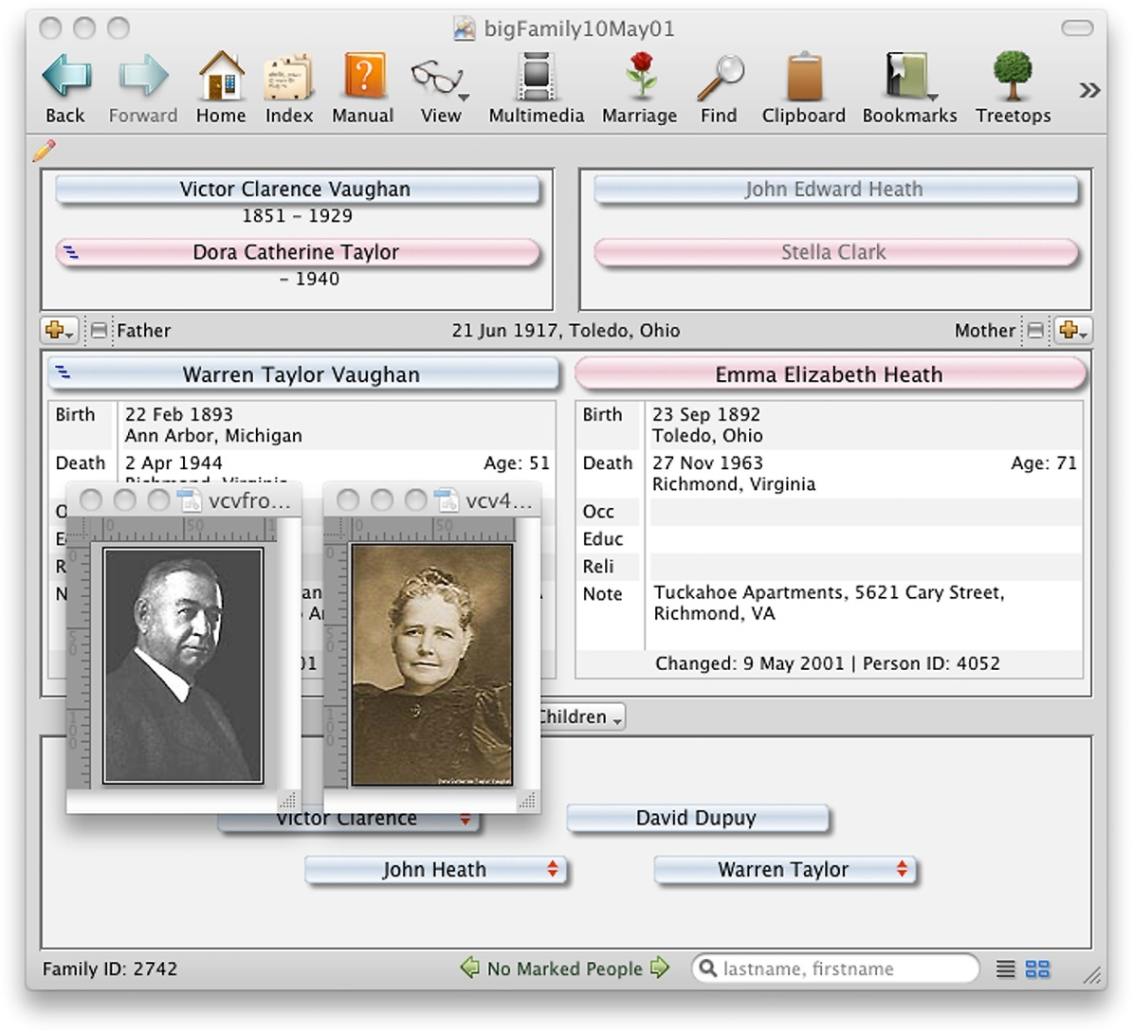
Applications of Multimedia (continue–who/when/where/whyd)
Home - Most multimedia projects reach homes via television sets or monitors with built-in user inputs.
Genealogy software such as Reunion from Leister Productions lets families add text, images, sounds, and video clips as they build their family trees.

Slide 15

Applications of Multimedia
–who/when/where/why
Public places - Multimedia will become available at stand-alone terminals or kiosks to provide information and help.
Kiosks in public places can make everyday life simpler.

Slide 16
Authoring tools -how
Authoring tool (A.K.A. authorware ): software allowing the user to create multimedia applications for manipulating multimedia objects.
Authoring tools are used to merge multimedia elements into a project.
These software tools are designed to manage individual multimedia elements and provide user interaction.

Slide 17
Delivering Multimedia -how
Primary multimedia delivery methods:
CD-ROM (Compact disc read-only )
DVD (Digital Versatile Disc )
Internet
Virtual Reality (VR)
Augmented Reality (AR)

Slide 18
Delivering Multimedia -how
Virtual reality (VR)
Virtual reality (VR) is a computer-generated scenario that simulates a realistic experience.
Virtual reality is an extension of multimedia.
It uses the basic multimedia elements of image, sound, and animation.
It requires terrific computing horsepower to be realistic.
Augmented Reality (AR)systems may also be considered a form of VR that layers virtual information over a live camera feed into a headset, or through a smartphone or tablet device.

Slide 19
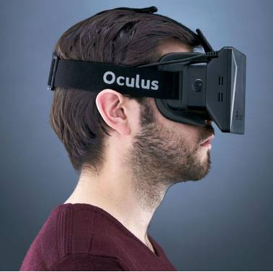
Delivering Multimedia -how
Virtual reality (VR)
Oculus Rift: consumer-focused virtual-reality headset
Oculus Go: Oculus Go standalone VR headset
https://www.oculus.com/

Slide 20
Summary
Multimedia is a combination of text, graphic art, sound, animation, and video.
Multimedia projects can be linear or nonlinear.
Multimedia projects are often stored on CD-ROM or DVDs. They can also be hosted on the Web.
Multimedia is widely used in business, schools, public places, and at home.
Virtual reality is an extension of multimedia.

Slide 21
Next Week
Text
Survey paper

Slide 22
Thank you!

